Slide 1
Violence In Youth
An ADDHealth Analysis
Shayla Keegan, Nam Anh Nguyen, Boo Elliott,
Maeve Woltring, and Ally Chase

Slide 2
What we’re doing
In this research project, we are looking into how parent relationships interact with violent/aggressive behaviors in youth.
Prior research displays a correlation between family-focused and parent programs and a greater chance of violence prevention in youth (Sumner, Mercy, Dahlberg, Hillis, Klevens, & Houry), and the likelihood of bullying perpetration and lack of parental involvement/support (Hong, Espelage).
Additionally, parenting styles and behavior have been shown to influence problem solving skills and aggressive and violent behaviors in youth.
Gender also proves a relevant factor in the development of violent behaviors in youth, as males have been shown to exhibit a much higher rate of callous-unemotional behaviors and impaired emotional regulation (Falcon, Dobbins, & Stickle).

Slide 3
Why is this important?
Studying violence in youth touches many areas:
Informing public health and safety policy to reduce youth mortality and gun violence rates.
Refining how to intervene with violent behaviors, and identifying risk factors for violence from a social work approach.
Can help destigmatize the youth who engage in violent behavior by understanding why it is occurring
Direct further research

Slide 4
Research Questions
How do parent relationships interact with violent behaviors in youth?
Does a lack of closeness in a parent-child relationship lead to a greater risk of engaging in physical violence? (SK)
What are the impacts of level of physical development between genders? (MW)
Does rearing environment impact violent behavior in youth? (AC)
Does violent behavior between parents and children impact the development of problem solving skills? (NN)
Do problem solving skills impact violent behavior? (BE)

Slide 5
Constructs
Does a lack of closeness in a parent-child relationship lead to a greater risk of engaging in physical violence?
IVs: closeness with parent
DVs: physical violence
Does violent behavior between parents and children impact the development of problem solving skills? Can problem solving skills impact aggression?
IVs: parent over-control and closeness with parent
DVs: problem solving

Slide 6
Constructs
Environment: We are focusing on self-reported unsafe neighborhoods scaling from the score of 3 to 5 from data H1NB5 in the Codebook.
Moderator:
Gender: Male and Female
Environment: Urban, Suburban, Rural
Mediator: Problem Solving Skills, Qualities of Parent Relationship

Slide 7
Hypothesis
Our preliminary hypothesis is that a lack of parental closeness plays a role in violent behaviors in youth, and items such as gender and environmental setting being moderational correlates.
We also expect that parental violence will be the most significant determinant, and will impact development of problem solving skills.

Slide 8
EXPECTED FINDINGS
Variable | Variable Type | Predicted Relationship to Violence Scale | Predicted Relationship to Parent Closeness
Puberty / Development | Moderator | High level of pubescence=high violence Low level of pubescence=low violence | High pubescence=low closeness
Impulsivity / Problem Solving | Mediator | Higher impulsivity leads to higher violence | Lower Parental closeness = high impulsivity
Parent Relationship Stability | Mediator | Negative Correlation for both boys and girls: low stability = higher violence | Negative Correlation for both genders: low stability = low closeness
MOM & DAD closeness, respectively | Mediator | Negative Relationship: higher closeness = lower violence | Positive Relationship: high closeness to Mom and Dad individually = high parent closeness
Rearing Environment | Moderator | Urban environment - high violence; rural environment - low violence | --

Slide 9
Primary Hypothesis (Mediator)
Closeness with parent
Environment
Physical Aggression
Problem Solving Skills
Puberty/Development

Slide 10
METHODS

Slide 11
Procedure
IN HOME COMPONENT:
To gather the data for this study, participating schools provided a roster of all students enrolled. From these rosters and the pool of participants in the in-school survey, adolescents in grades seven to twelve were sampled to participate in the in-home interview. These adolescents were interviewed at two points, once during Wave I and again a year later during Wave II.
PARENT INTERVIEW COMPONENT:
A participant’s parent or guardian was interviewed during Wave I of the study to provide further information about the family composition and the adolescent’s health history. The questionnaire asked demographic and health-related information about the parent or guardian and general question about the adolescent respondent.

Slide 12
Sample
National Sample: 80 high schools selected are representative of US schools with respect to region of country, urbanicity, size, type, and ethnicity.
70% of high schools participated, each identified a feeder school. Schools were sampled without replacement.
There were 90,118 students from 145 middle, junior, and high schools who completed a 45-minute questionnaire in the school. 20,745 of these adolescents were sampled to complete an in-home interview.
without replacement

Slide 13
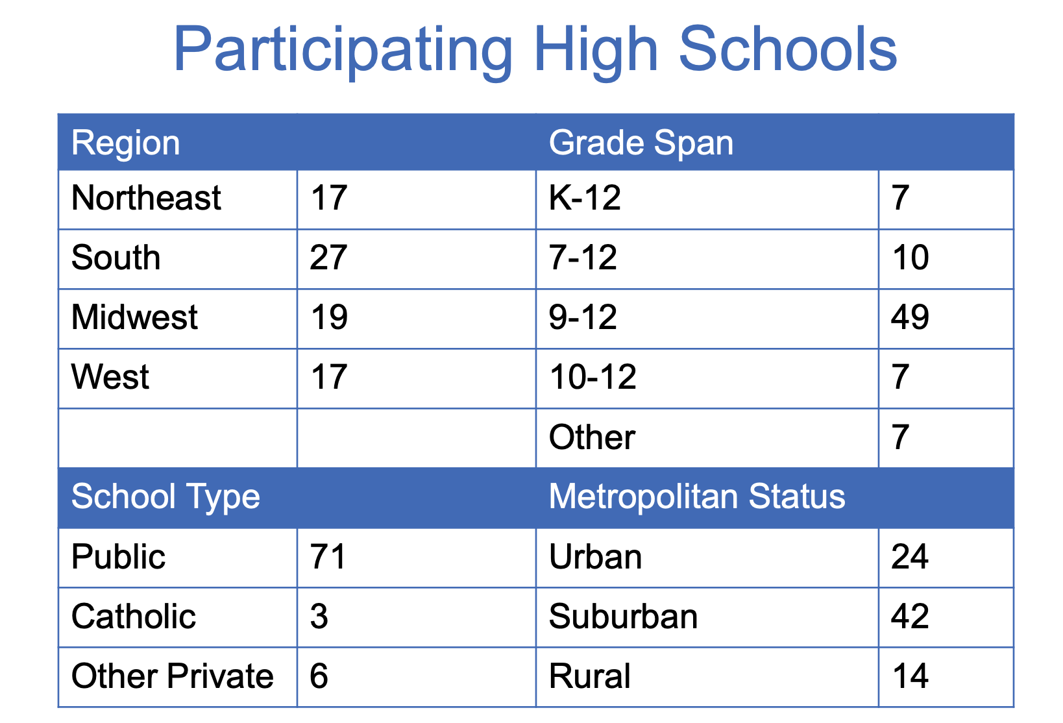
Sample

Slide 14
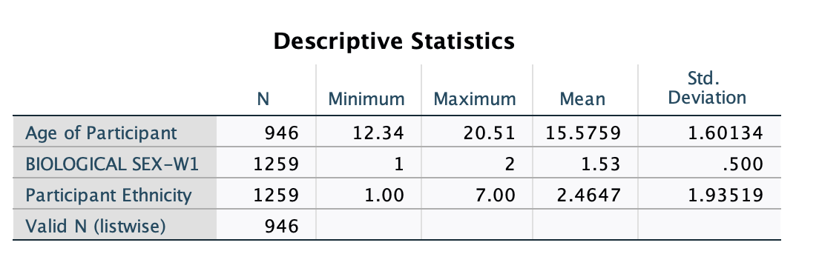
Sample cont’d.
Descriptives for demographics: ethnicity, age, gender

Slide 15
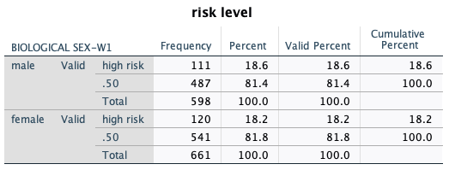
Subsample
To create the subsample, we combined the variables for neighborhood safety and school safety into one dichotomous variable representing risk level, with values of low and high risk, as well as a 0.5 value where individuals indicated having neighborhood OR school safety, but not both.
We used a select statement to include only those who are at high risk or at a 0.5 value in our tests and analysis. This subsample is about 20% of the larger sample. We also ran a split file to show results by gender. Below is the frequency with the select case and split file.
We initially intended to Select Case by our variable ‘Risk Level’ (high risk versus low risk environments were coded using the questions do you feel safe in your neighborhood and school, respectively), but due to there being only about 400 participants in the high risk category,

Slide 16
Closeness Construct (mediator)
case_PARENT_CLOSENESS:
Used total of 27 questions from the Relations with Parents section (where a couple of them had a multitude of sub-questions) from ADD Health Codebook that related to parental closeness between child and parent
Averaged up all of the general questions and the ones specific to a mother figure to create new_CLOSENESS_MOM
Averaged up all of the general questions and the ones specific to a father figure to create new_CLOSENESS_DAD
Computed mean of new_CLOSENESS_MOM and new_CLOSENESS_DAD to create a PARENT_CLOSENESS
Recoded PARENT_CLOSENESS into categorical variable case_PARENT_CLOSENESS
EXAMPLE ITEMS:
General: On how many of the last 7 days was at least one of your parents in the room with you while you ate your evening meal?
Mom: How close do you feel to your {MOTHER/ADOPTIVE MOTHER/STEPMOTHER/FOSTER MOTHER/etc.}?
How much do you think she cares about you?
Dad: How close do you feel to your {FATHER/ADOPTIVE FATHER/STEPFATHER/FOSTER FATHER/etc.}?
How much do you think he cares about you?

Slide 17
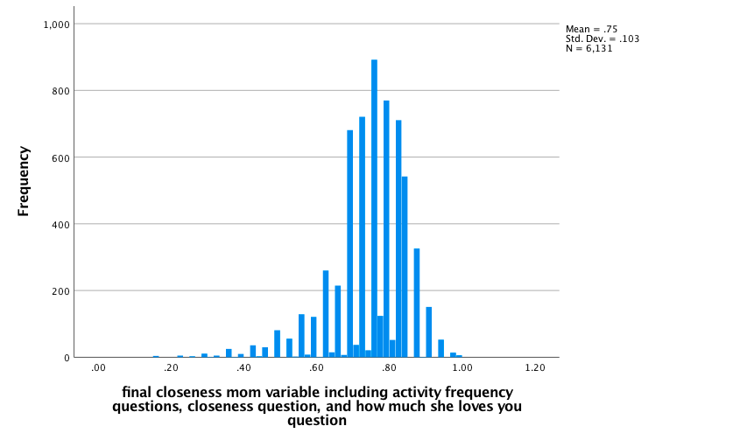
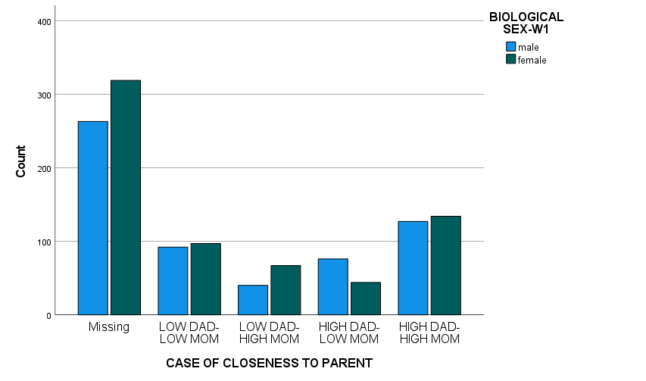
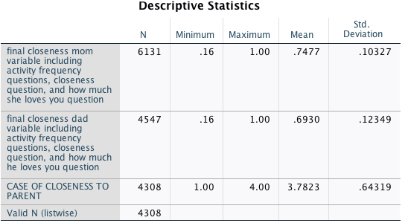
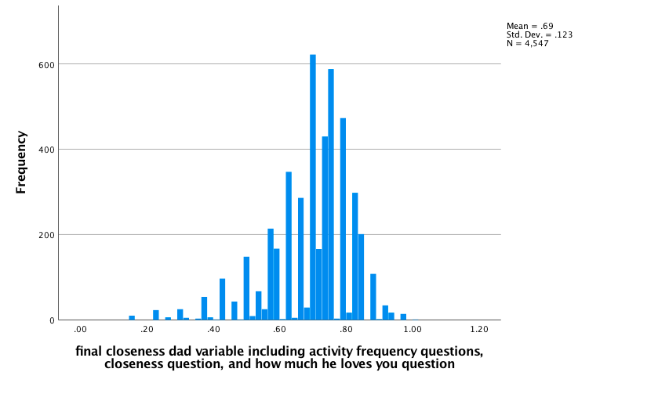
case_PARENT_CLOSENESS , new_CLOSENESS_MOM , new_CLOSENESS_DAD - Descriptive Statistics

Slide 18
Parent Relationship Construct (moderator)
I used the Parent Questions Codebook & selected 3 items that were asked of individuals in marriage-like relationships:
Rate happiness in current relationship (values = scale of 1-10) (PB18)
Have you discussed separating? (values = yes or no) (PB19)
How often do you fight with your partner? (values = ‘a lot,’ ‘rarely,’ etc) (PB20)
The Parent Relationship Stability Measure I created by recoding the questions into a scale with a range of 0-3, and computing the mean of the 3 items (PB18-PB20) to get the new variable (r_PR_STABILITY).
0 was coded as ‘single parent’ (legitimate skips),
1 was coded as ‘unstable’ (happiness rating original values of 1-3, fighting often - original value of 1, and discussions of separating - original value of 1),
2 was coded as moderate (happiness ratings of 4-6, and original values for fighting with partner of 2-3),
3 was coded as stable (happiness ratings of 7-10, no fighting - original value 4 or discussions of separation - original value 2).

Slide 19
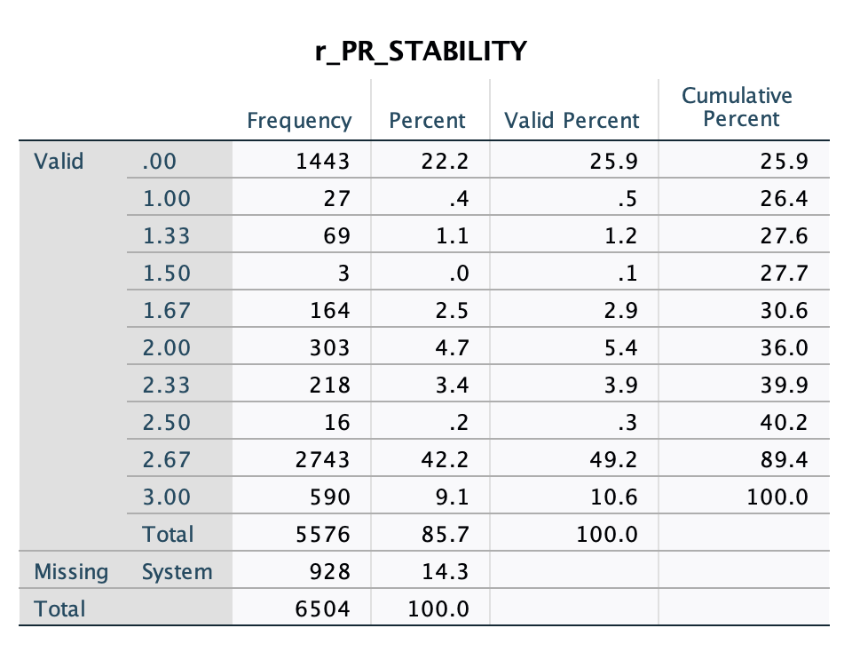
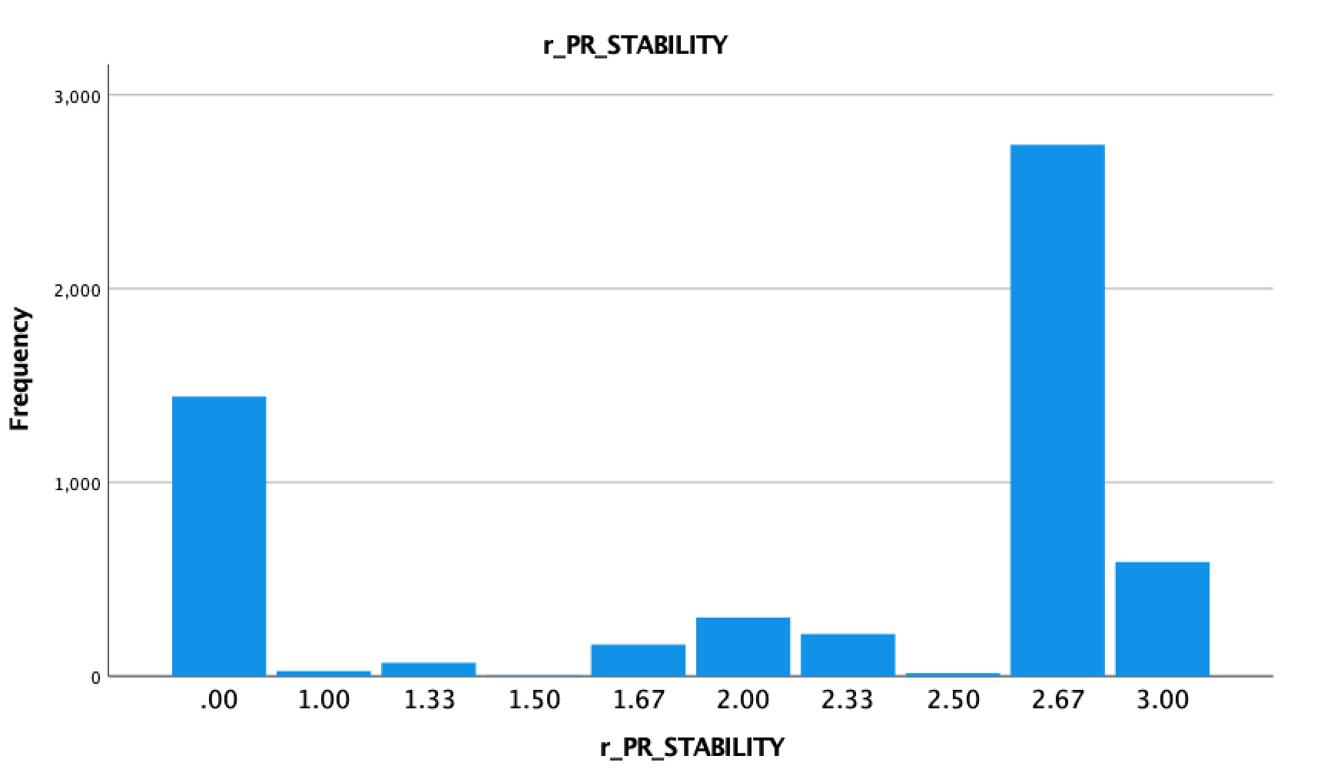
Parent Relationship Stability descriptive statistics and frequencies.

Slide 20
Gender Construct/Youth Level of Physical Development (Moderator)
I used 3 variables to account for gender:
-BIO_SEX (from the General Introductory section of the ADD Health Data Codebook), which tracks respondents biological gender (this variable did not need to be recoded as it simply categorizes participants into a binary, with only one participant opting for the third option: “refused”).
-H1MP4 and H1FP6, which account for self-reported perception of physical development for boys and girls, from the Male Physical Development and Female Physical Development codebooks respectively.
Recoding:
-Added the variable labels Male Physical Development and Female Physical Development to the two development variables
-Added Value labels to all 3 variables in accordance to codebook-- for biological gender, 1 is ‘male’ and 2 is ‘female’, For the level of physical development variables value labels ranged from 1 to 9, with 1 representing the response ‘i look younger than most’, 5 representing ‘i look older than most’, 2-4 representing all intermediate stages of development (between underdeveloped and overdeveloped) and 6-9 representing missing values (‘refused’, “don’t know”, and ‘not applicable’)
-Added missing values- 6 for biological gender, and 6-9 for level of physical development
-Recoded gendered development into 3 categorical variables:

Slide 21
Gender Construct (Moderator) cont’d.
-Recoded level of physical development values (for males and females) into aforementioned categorical variables 1-3, with 1=1, 2=1, 3=2, 4=3, and 5=3-- these new values now exist under the recoded variable labels r_H1MP4 and r_H1FP6
-Entered new value labels for male physical development and female physical development to define my new 1-3 value scale: 1 is ‘under developed’, 2 is ‘normally developed’, and 3 is ‘overdeveloped’

Slide 22
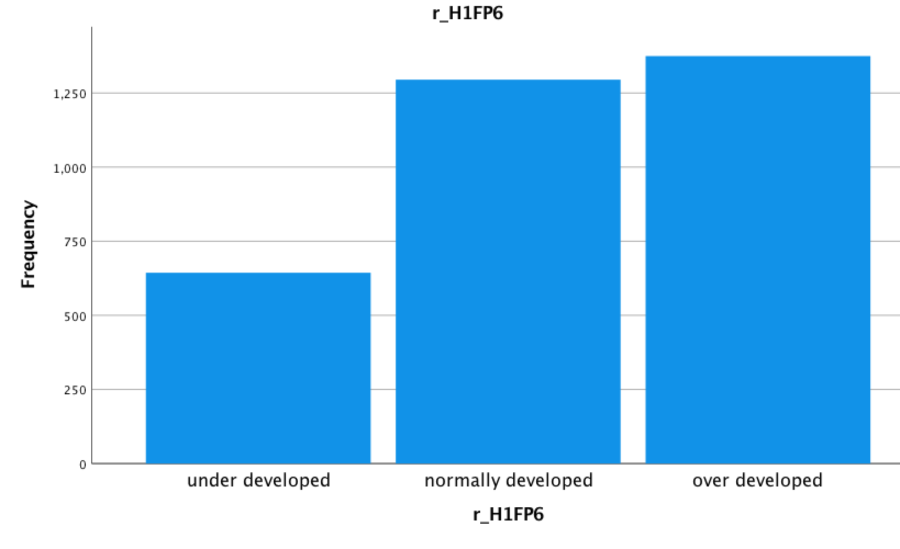
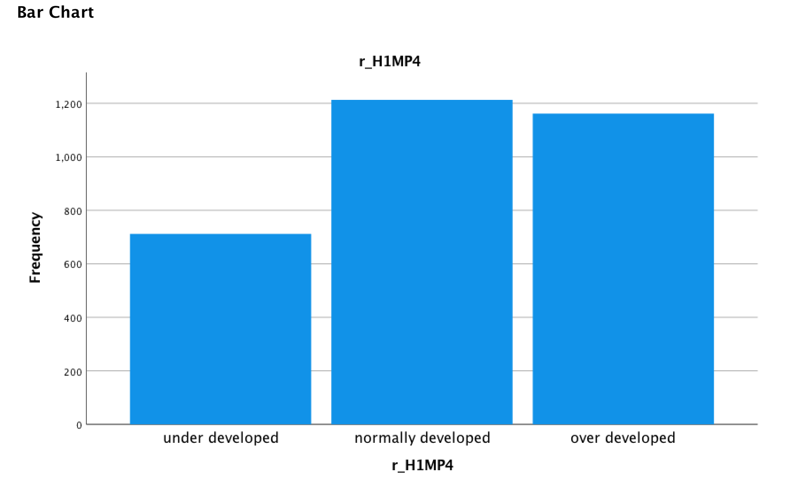
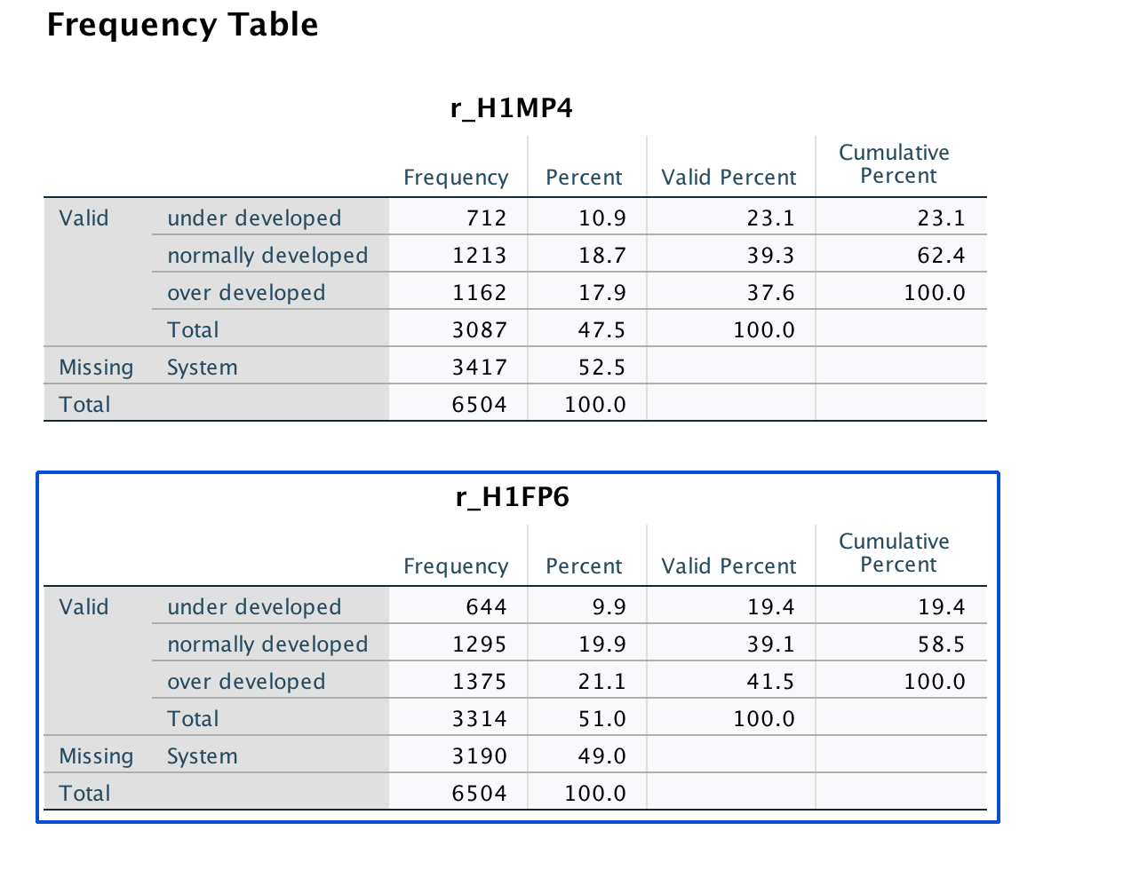
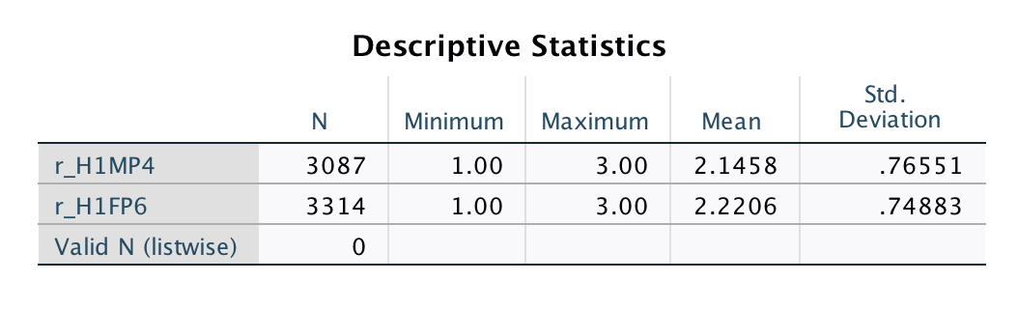
r_H1MP4 and r_H1FP6 DESCRIPTIVE STATISTICS

Slide 23
Construct: Environment (moderator)
I used the General Introductory section of the ADD Health Data Codebook, and focused on the one question which asked about the type of environment the participant lived in: “How would you describe the immediate area or street (one block, both sides) where the respondent lives?” \
This question had five possible responses— 1 ‘rural’ 2 ‘suburban’ 3 ‘urban, residential only’ 4 ‘3 or more commercial properties, mostly retail’ 5 ‘3 or more commercial properties, mostly wholesale or industrial’, as well as four response options that would be considered missing values: 6 ‘other’ 96 ‘refused’ 98 ‘don’t know’ 99 ‘not applicable’. First I added all of these response options as value labels for the variable I renamed “environment,” and then added 6 and 96-99 as missing values.
Then I recoded “environment” into a new variable “r_environment”, for which I combined all of the “urban” values (3-5) to fall under one value of “urban”, changing the values for the recoded categorical environment variable “r_environment” to be only 1 ‘rural’ 2 ‘suburban’ and 3 ‘urban.” I added a label for this final variable of “new environment variable.”

Slide 24
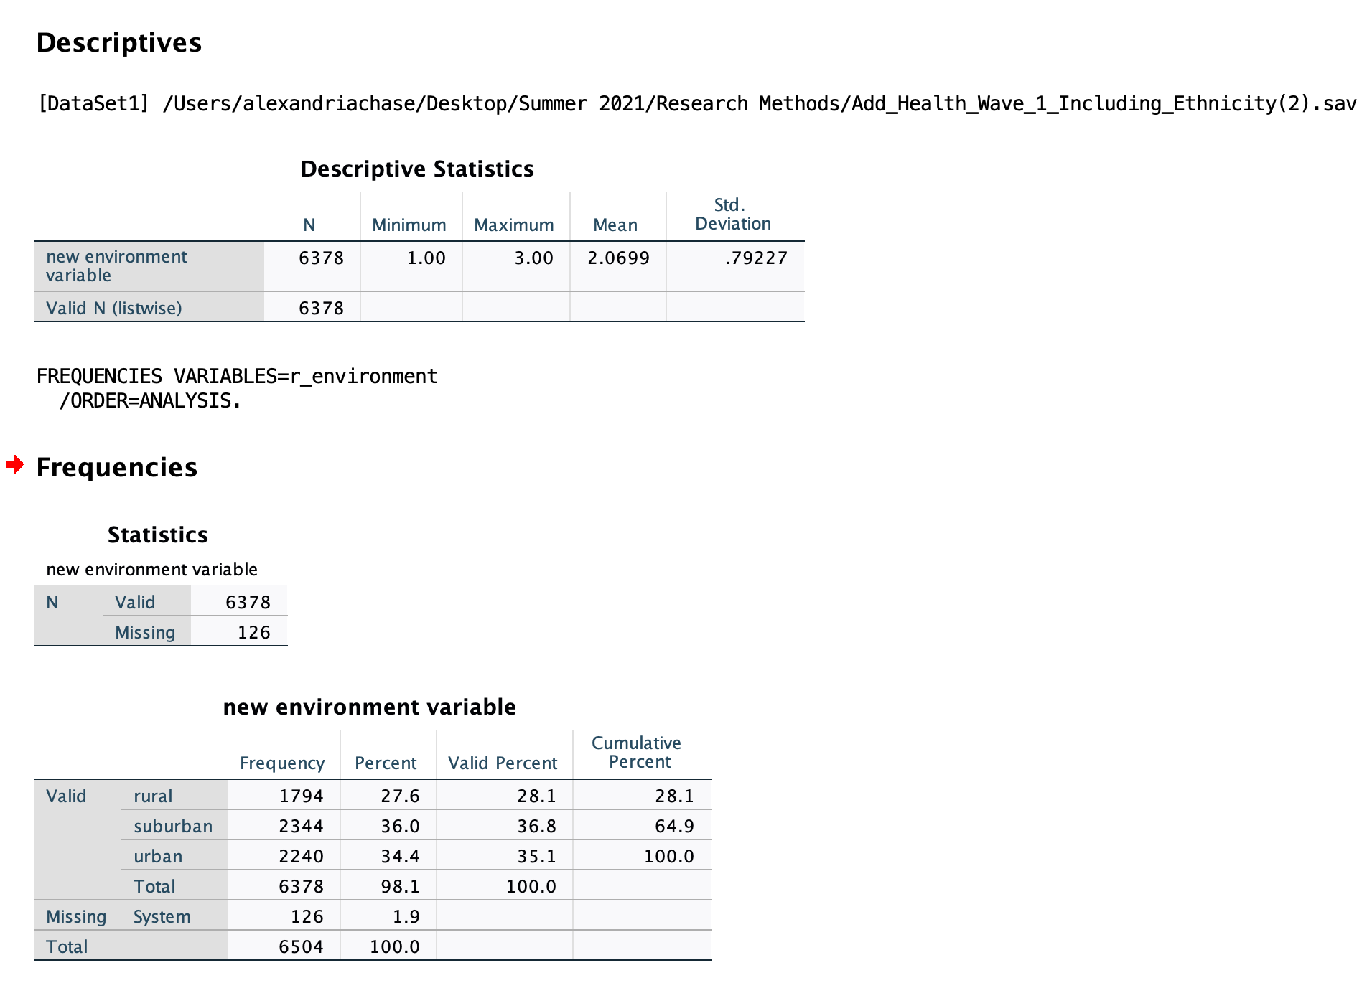
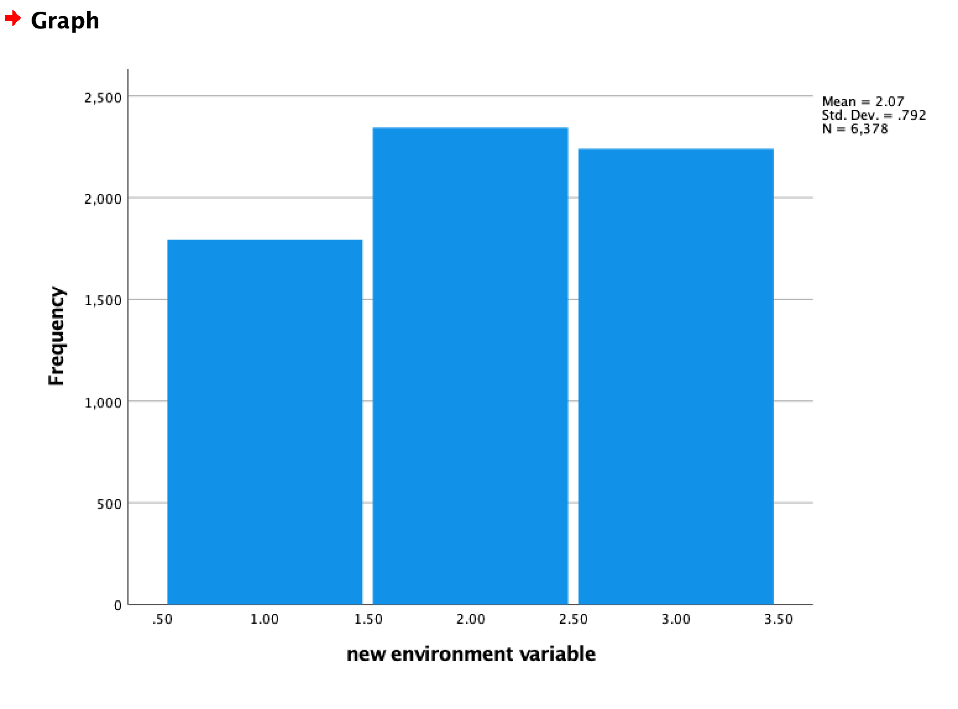
r_environment - Descriptive Statistics

Slide 25
Construct: Problem Solving Skill
I used 11 variables in the Personality and Family Section:
All in the scale of 1-5, where 1= strongly agree and 5= strongly disagree.
H1PF7 - Never argue with other people.
H1PF13 - You never criticize other people.
H1PF29 - You are well coordinated.
H1PF15 - Difficult problems make you very upset.
H1PF26 - You have a lot of energy.
H1PF16 - Go with your 'gut feeling' without thinking too much about the consequences of each alternative. *H1PF15, H1PF16, H1PF26 are reverse coded.

Slide 26
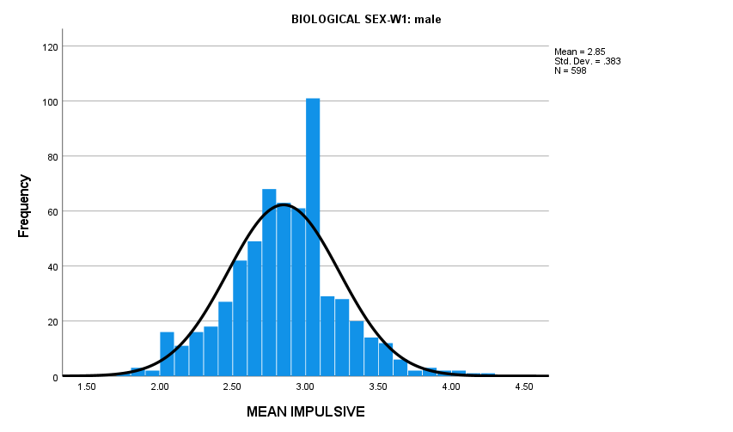
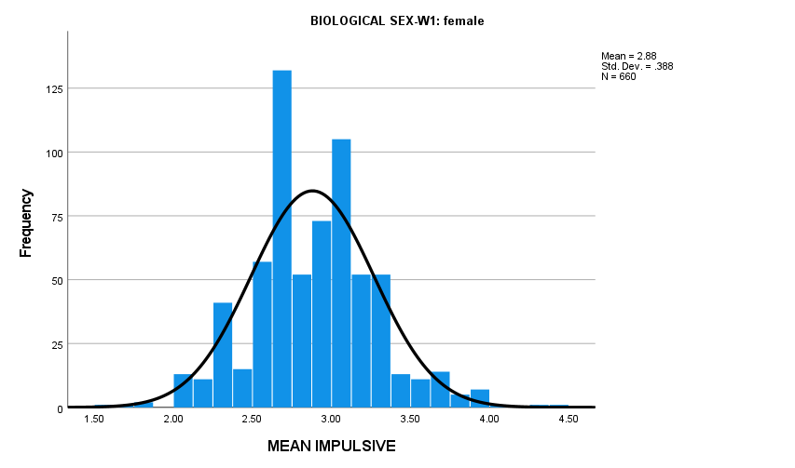
Construct: Problem Solving Skill
Linear Variable: IMPULSE - scale for problem solving.
IMPULSE = MEAN of all these variables.
IMPULSE’s Scale 1 - 5 with:
1 = low impulsive
5 = high impulsive
Dichotomous Variable: IMPULSIVITY
1-2.74 → 1, low impulsivity
2.74-3 → 2, medium impulsivity
3-maximum → high impulsivity

Slide 27
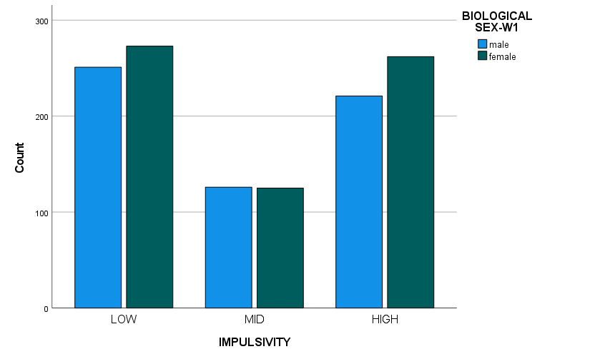
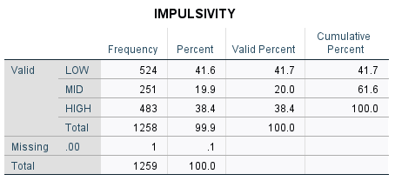
Construct:
Problem Solving Skill

Slide 28
Construct: Violence
VARIABLES USED:
5 variables in Delinquency Scale:
H1DS2 "In the past 12 months, how often did you deliberately damage property that didn’t belong to you?"
H1DS5 "How often did you get into a serious physical fight?"
H1DS6 "How often did you hurt someone badly enough to need bandages or care from a doctor or nurse?"
H1DS11 "How often did you use or threaten to use a weapon to get something from someone?"
H1DS14 "In the past 12 months, how often did you take part in a fight where a group of your friends was against another group?"
Original scale:
0 = never, 1 = 1 to 2 times, 2 = 3 to 5 times, 3 = 5 or more than 5 times
Recoded scale:
0=never, 1=1 to 2 times, 2=3 or more times

Slide 29
Construct: Violence
VARIABLES USED CONT’D:
3 variables in Fighting and Violence:
H1FV7: During the past 12 months, how often did the following happen? You pulled a knife or gun on someone.
H1FV8: During the past 12 months, how often did the following happen? You shot or stabbed someone.
Original Scale, and the scale we used:
0 = never, 1 = once, 2 = more than once
H1FV13: During the past 12 months, how many times were you in a physical fight in which you were injured and had to be treated by a doctor or nurse?
Original Scale:
Linear, answers ranging from 0 -365
Recoded Scale: 0 = 0, 1=1-182 times, 2=183-365 times

Slide 30
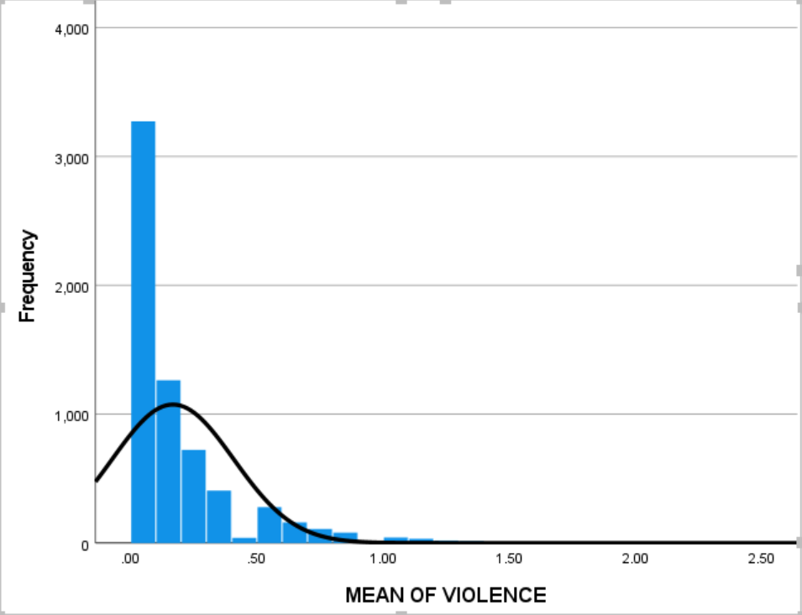
Construct: Violence
Compute
Violence = Mean of all variables
With the scale of 0 - 2:
0 = low violence
2 = high violence

Slide 31
RESULTS

Slide 32
Initial approach to analyses
In our analysis decisions, we began with exclusion criteria: we ran a regression to double check that high risk was associated with high violence, which it was (t = -13.322, df = 1, p = <0.001).
We coded our Select Case as any values below low risk (1), which increased our subsample to about 1200 participants (N = 1219) (as explained in the subsample slide).
We then split file for all of our analysis on the basis of biological sex, as we expected differences in parental closeness, maturation variables (impulsivity, physical development, etc) and violence on the basis of gender.

Slide 33
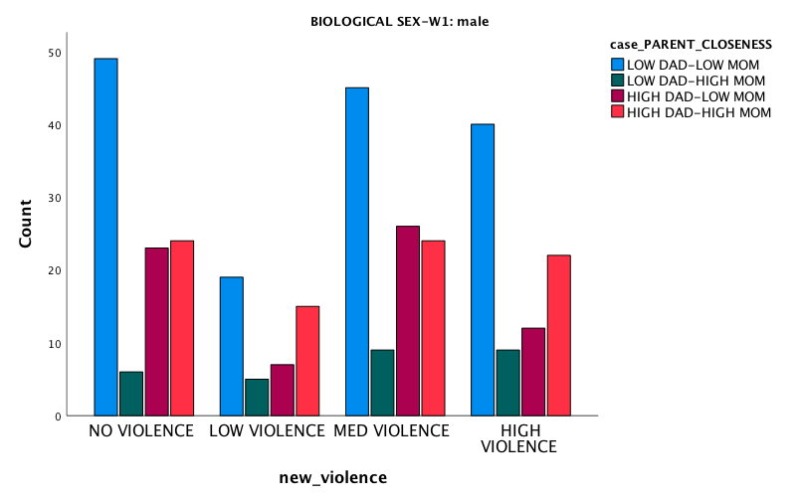
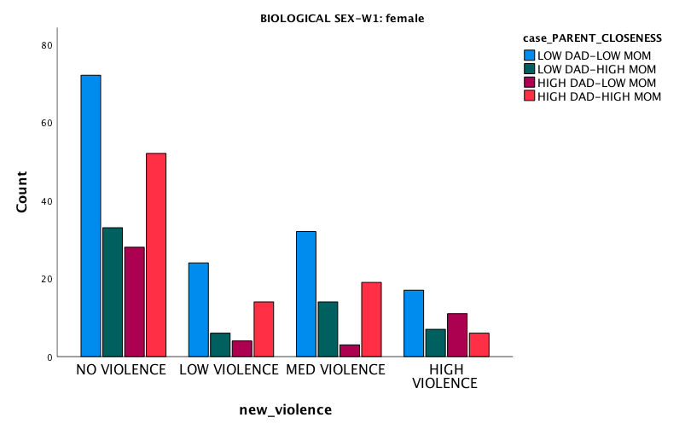
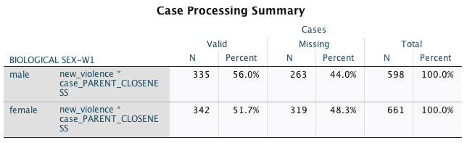
Does a lack of closeness in a parent-child relationship lead to a greater risk of engaging in physical violence?
To determine whether a lack of closeness in a parent-child relationship leads to a greater risk of engaging in physical violence, I ran a Pearson Chi-Square test. [Violence was split into levels of ‘no violence’, ‘low violence’, ‘medium violence’, and ‘high violence’. Parental Closeness was split into levels of ‘low dad-low mom’, ‘low dad-high mom’, ‘high dad-low mom’, and ‘high dad-high mom’. Results indicate that there is no statistically significant relationship between the variables for both male and female (male: x² = 6.901, df = 9, p = .647 // female: x² = 16.049, df = 9, p = .066).

Slide 34
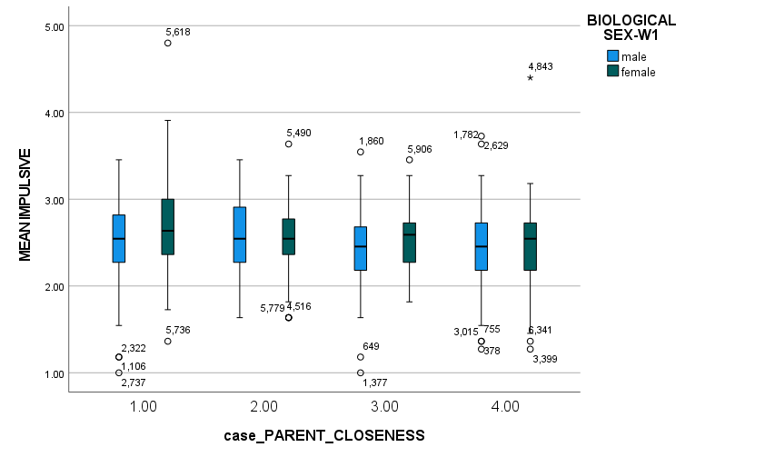
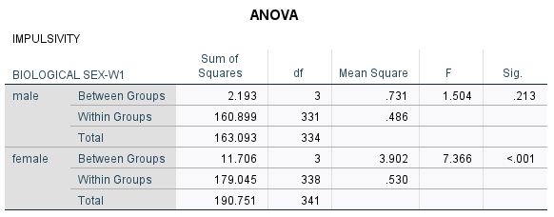
Results: Does parent closeness predict violence behavior via impulsivity?
We ran an ANOVA test to determine if youth impulsivity varied by parent-child closeness. The results indicate that only female impulsivity varies by parent-child closeness (male: F = 1.504; df = 4, 593; p = 0.338)(female: F = 5.286; df = 4, 656; p < 0.001).

Slide 35
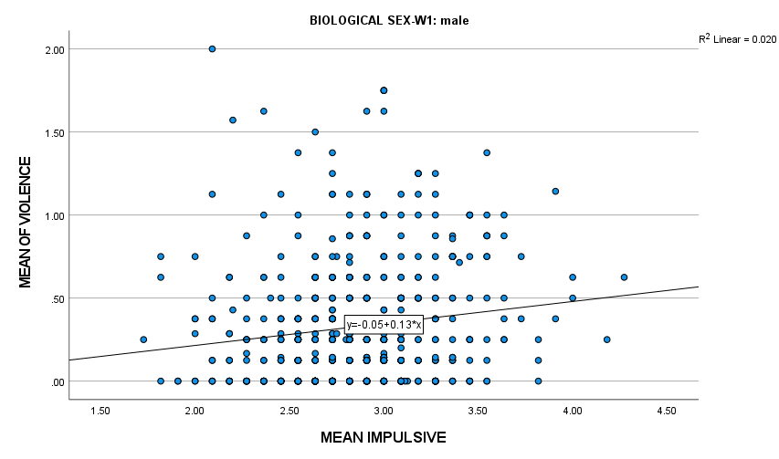
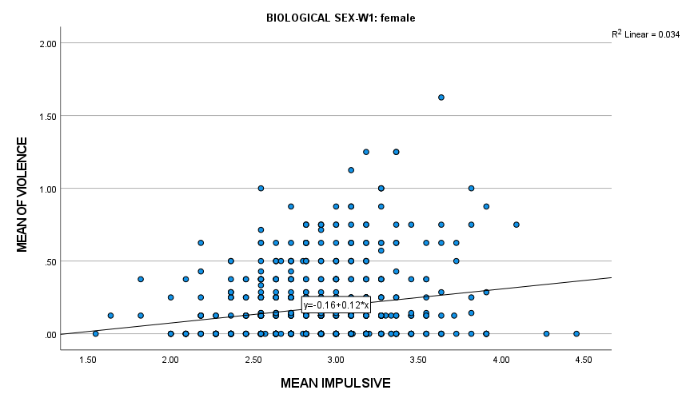
Results: Does parent closeness predict violent behavior via impulsivity?
We then ran a regression to examine if impulsivity predicts violent behavior. Results indicate that impulsivity predicts violence behavior in both genders
(male: t = 3.484; p <0.001)(female: t = 4.813; p < 0.001).

Slide 36
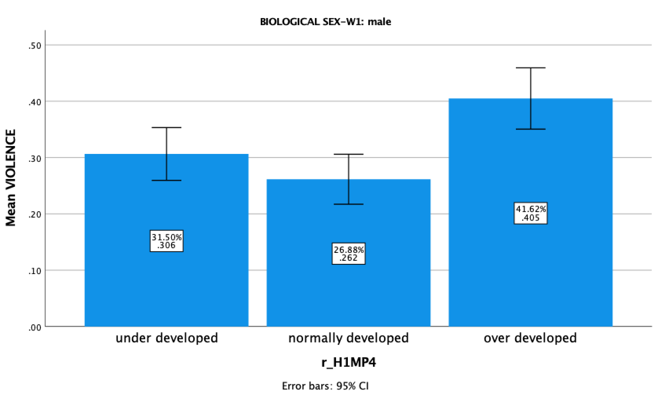
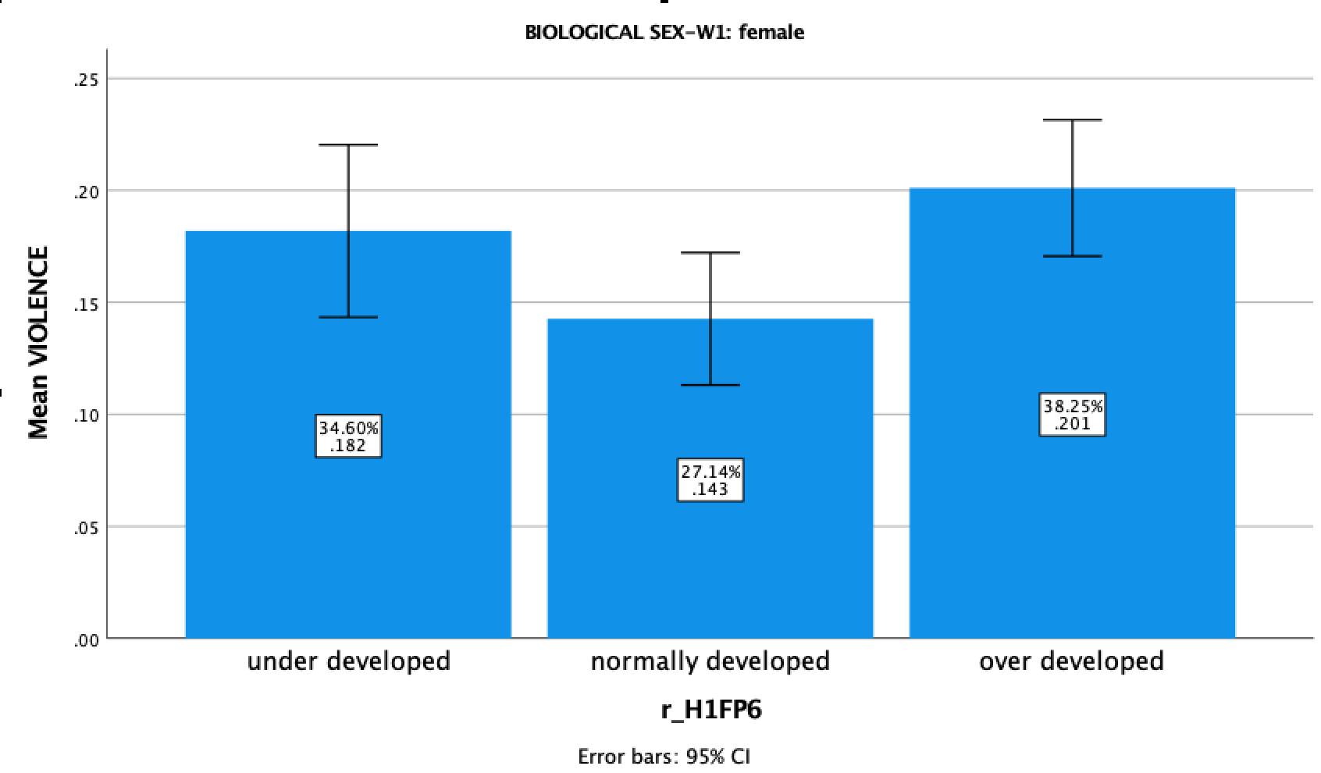
Testing violence by puberty
We ran an ANOVA to determine if violence varied by level of physical development (puberty). Results indicated that there was a significant difference for both males (F=9.250, df=2,577, p=<0.001), and females (F=3.545, df=2,64, p=0.029).
Both boys and girls tend to have higher violence scores if they’re at an advanced stage of puberty compared to their peers, with females that are behind normal development approaching significantly higher scores as well.

Slide 37
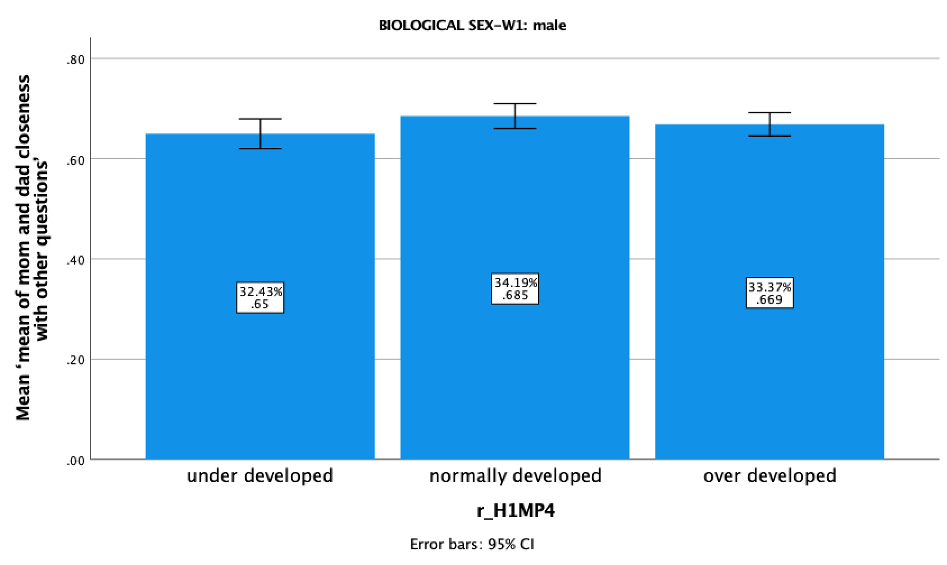
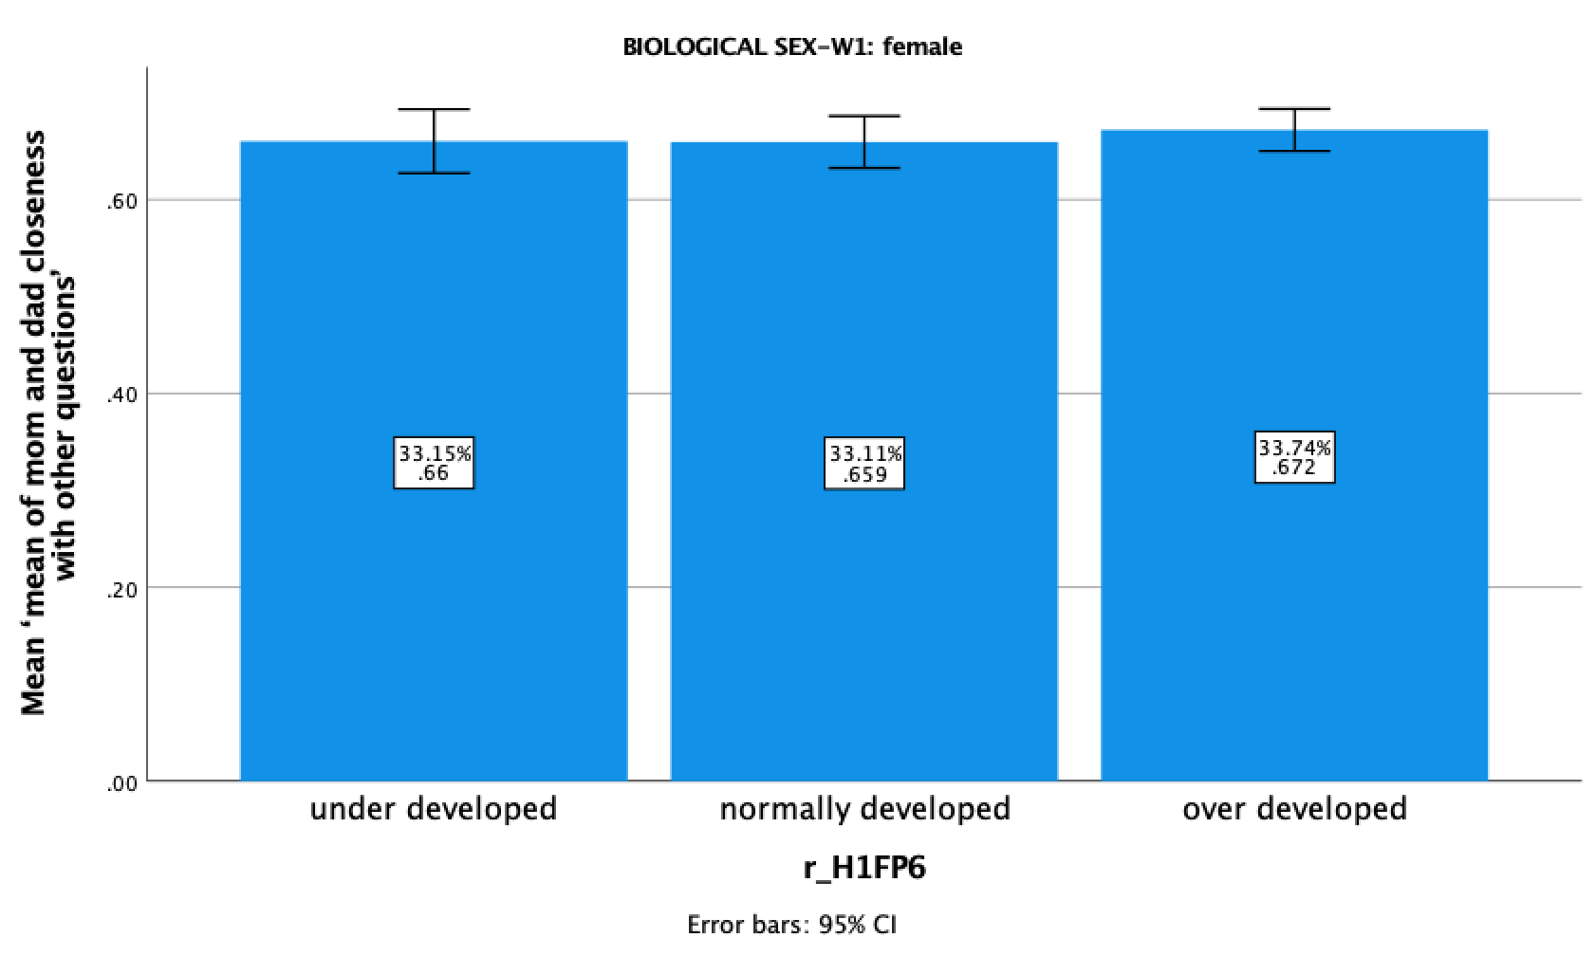
Testing parent closeness by puberty
We ran an ANOVA to determine if parental closeness differed by level of pubsesent development in males and females. Results indicated that there was no difference for either. (males: F = 1.695, df = 2, 564, p = 0.184, females: F = 0.315, df = 2, 620, p = 0.730).

Slide 38
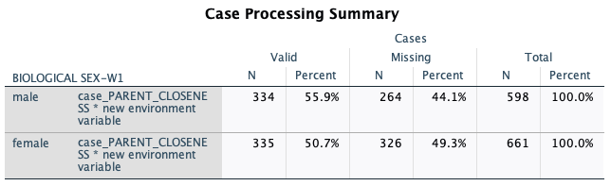
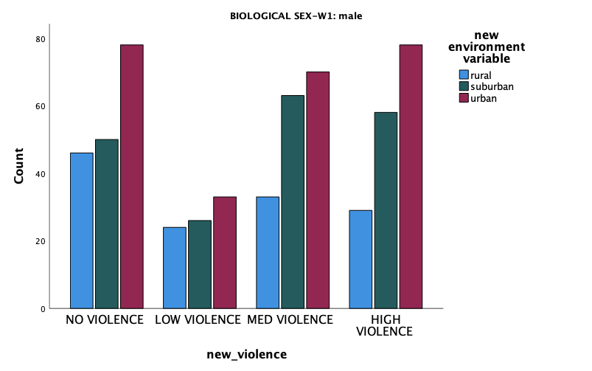
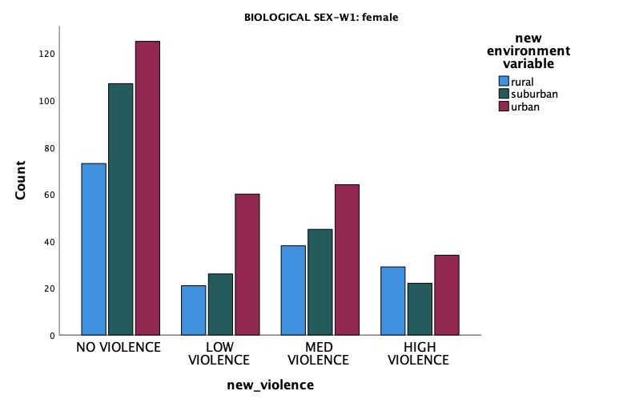
Results: Does rearing environment impact violent behavior in youth?
We ran a Pearson chi-square to determine if violence varied by environment (urban, suburban, and rural). Results indicate that it did not for males, but it did for females (males: x²= 8.318, df=6, p<0.216), (females: x²= 12.648, df=6, p<0.049). Females in urban environments have higher levels of violence.

Slide 39
Regression between violence and parent closeness, respectively, by parent relationship stability
REGRESSION 1:
We ran a regression to determine if there is a relationship between violence and parent relationship stability. We found that there was no significant relationship in male or female participants. (male: t = 13.996, df = 1, p = 0.084, female: t = 10.908, df = 1, p = 0.324).
REGRESSION 2:
We ran a regression to determine if there is a relationship between parent(-child) closeness and parent relationship stability. We found that there was no significant relationship for males ( or female participants. (male: t = 1.514, df = 1, p = 0.131) but there was a relationship for females:, female: t = 3.071, df = 1, p = 0.002).
★ There was a positive, but weak, correlation for parent relationship stability and parent closeness in females (r = 0.132, p = 0.002).
(GRAPHS ON NEXT SLIDE)

Slide 40
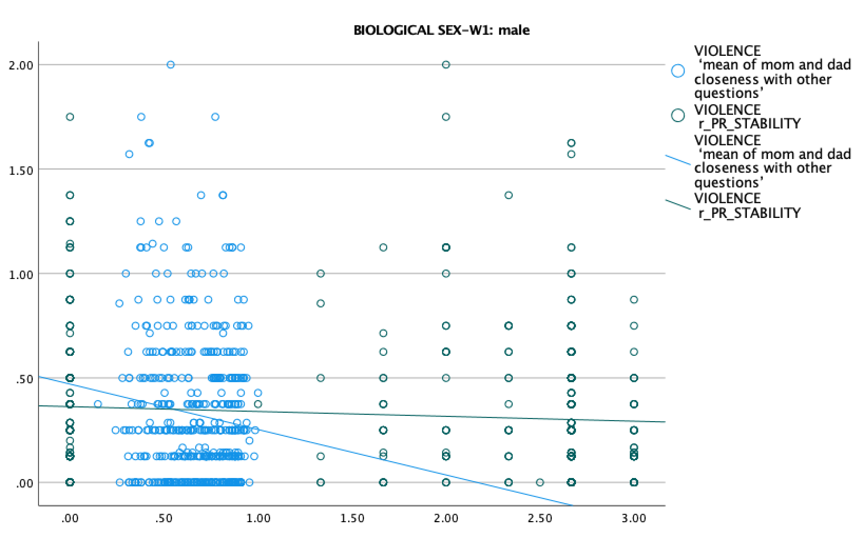
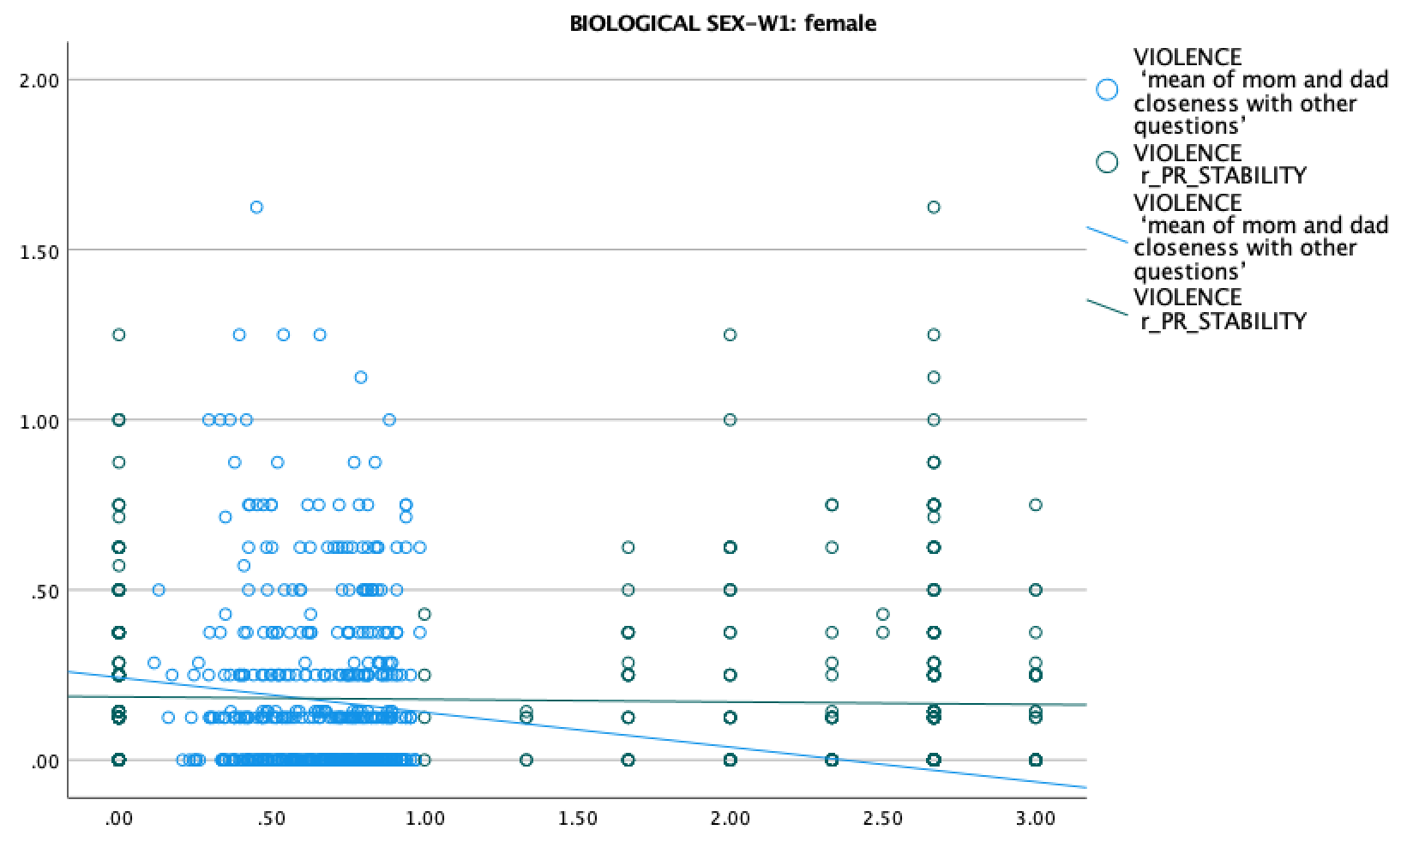
Graphs for violence and parent closeness by parent relationship stability

Slide 41
CONCLUSION

Slide 42
How do parent relationships interact with violent behaviors in youth?
Studying violence in youth is important because it helps tackle the issue of youth mortality rate as a consequence of violence, it helps us refine intervention tactics and direct future research, and it can help destigmatize youth that engage in violent behavior.
Our conclusions from our research are as follows:
Shayla: Parental closeness with the child is not a significant factor in the youth’s engagement in violence in both boys and girls.
Ally: Environment does not have a significant impact on violent behaviors in adolescent boys. In girls, environment does impact their behavior, and those who live in urban environments had higher levels of violence.
Maeve: In participants with a higher level of physical development (puberty) than their peers, violence scores were higher for both genders, but there was no significance found between puberty and parent closeness.
Boo: There was no statistically significant difference in violence in relation to the stability of parent’s relationships.
Nam Anh: Impulsivity can be a mediator between parent-child closeness and violence behavior for female gender. Parent-child closeness does not related to violence behavior when we take impulsivity as our mediator.

Slide 43
Steps for Future Research
Looking more into why environment and impulsivity impacted only female youth violent behaviors
Delve deeper into which relationships do affect violent behavior - since parent relationships do not have a statistically significant effect on violence in youth, what relationships in adolescents’ lives do?
Possible avenues to explore: friendships; sibling relationships; mentor/mentee relationships
Could also study how parents regulate their emotions and how this impacts the way their children regulate their own emotions, specifically the emotions (i.e. anger) that lead to violent behaviors.
Looking at how the adolescent’s school goes about punishment (is it focused on rehabilitation? Is it just suspension?), and how these different forms of discipline affect violent behavior in youth.

Slide 44
REFERENCES

Slide 45
References
Dahlberg, L. L. "Youth Violence in the United States - Major Trends, Risk Factors, and Prevention Approaches." American Journal of Preventive Medicine 14, no. 4 (May, 1998): 259-272. doi:10.1016/S0749-3797(98)00009-9.
Hahn, Robert, Dawna Fuqua-Whitley, Holly Wethington, Jessica Lowy, Alex Crosby, Mindy Fullilove, Robert Johnson, et al. "Effectiveness of Universal School-Based Programs to Prevent Violent and Aggressive Behavior - A Systematic Review." American Journal of Preventive Medicine 33, no. 2 (AUG, 2007): S114-S129. doi:10.1016/j.amepre.2007.04.012.
Hoeve, Machteld, Judith Semon Dubas, Veroni I. Eichelsheim, van der Laan, Peter H., Wilma Smeenk, and Jan R. M. Gerris. "The Relationship between Parenting and Delinquency: A Meta-Analysis." Journal of Abnormal Child Psychology37, no. 6 (AUG, 2009): 749-775. doi:10.1007/s10802-009-9310-8.
Sumner, S. A., Mercy, J. A., Dahlberg, L. L., Hillis, S. D., Klevens, J., & Houry, D. (2015). Violence in the united states status, challenges, and opportunities. Jama-Journal of the American Medical Association, 314(5), 478-488. doi:10.1001/jama.2015.8371.
Dodge, K. A., & Newman, J.P. (1981). Biased decision-making processes in aggressive boys. Journal of Abnormal Psychology, 90(4),375-379. doi:10.1037/0021-843X.90.4.375.
Lochman, J. E. & Lenhart, L.A. (1993). Anger coping intervention for aggressive-children - conceptual models and outcome effects. Clinical Psychology Review, 13(8), 785-805. doi:10.1016/S0272-7358(05)80006-6.

